Slide 1
The Tradeoff between Altruism and Economic Growth in the Research Focus of Nations
COST Workshop
Budapest, Hungary
August 29, 2016
Richard Klavans & Kevin W. Boyack
SciTech Strategies, Inc.
www.mapofscience.com

Slide 2
Agenda
Background
Methods
Data
Results
Discussion

Slide 3
Altruism and national research focus
We believe that altruism is a motive for national research
    Science, The Endless Frontier stated altruistic goals, particularly in medicine
Despite this, altruism seems not to have been considered explicitly in national research policy
Economic motives have dominated the discussion of national policy
Our intent is to explore why nations support research with altruistic characteristics, and to determine if
    Disciplines and fields vary with respect to altruism
    Nations vary with respect to altruism
    If altruistic intent correlates with other national features

Slide 4
Background: National research focus
Some work has focused on impact (as a proxy for focus), including pioneering work by May (Science, 1997) and King (Nature, 2004)
    Highly cited work, measured national impact (strength)
    Discussed some national differences, but not motives
Other work has focused more on strategies
    Doré (1996, 2001) identified four main strategies (Natural, Life, Agricultural, and Geo), nations tend to focus
    REIST-2 (1997) identified four strategies (Life, Natural, Engineering, Bio-Env)
    Moya-Anegon (2013) identified three strategies (BioMed, Basic S&E, Agricultural)
    Chen (2016) identified three strategies (Medical, Natural, Developing)
Some consensus on three main strategies
    BioMed (Life, Medical); Basic S&E (Natural); Agricultural (Bio-Env, Developing)

Slide 5
Background: National research focus
All of these studies leave room for potential improvement
    Each used subject categories or something similar; more accurate classifications of science exist
    Motive is not considered in strategy; altruism is not discussed at all

Slide 6
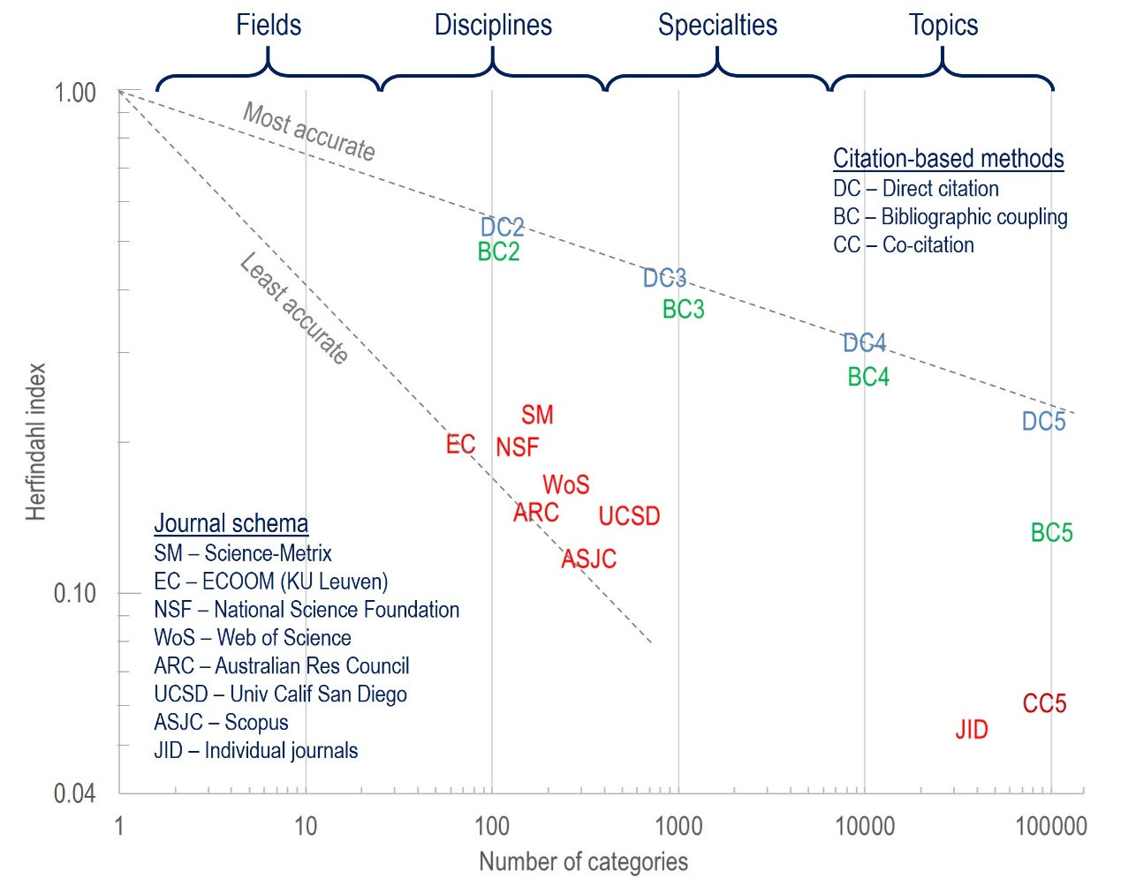
Background: Defining disciplines
Typically done using subject categories
Much more accurate methods now exist and should be tested
We will use DC2
(direct citation 10²)
categories

Slide 7
Background: Economic motive for research
Economic motivation for researc is historical
    Linneaus was funded by the Swedish crown to develop cold-hardy plants that would make Sweden wealthy through agriculture
    The U.S. established agricultural colleges in the late 19th Century
    Large labs accompanied economic growth in the 1930s
    Recently the scene has been dominated by open innovation systems and smaller labs
Much of the literature assumes the economic motive for research

Slide 8
Background: Altruism
There is some literature on altruism in the context of
    biological fitness and behavior
    cooperation (in the evolutionary dynamics and game theory sense)
    organ donation
    professionalism (particularly in medicine)
    medical education
    volunteerism
    citizenship
    monetary donation
But none that establishes the relationship between altruism and R&D

Slide 9
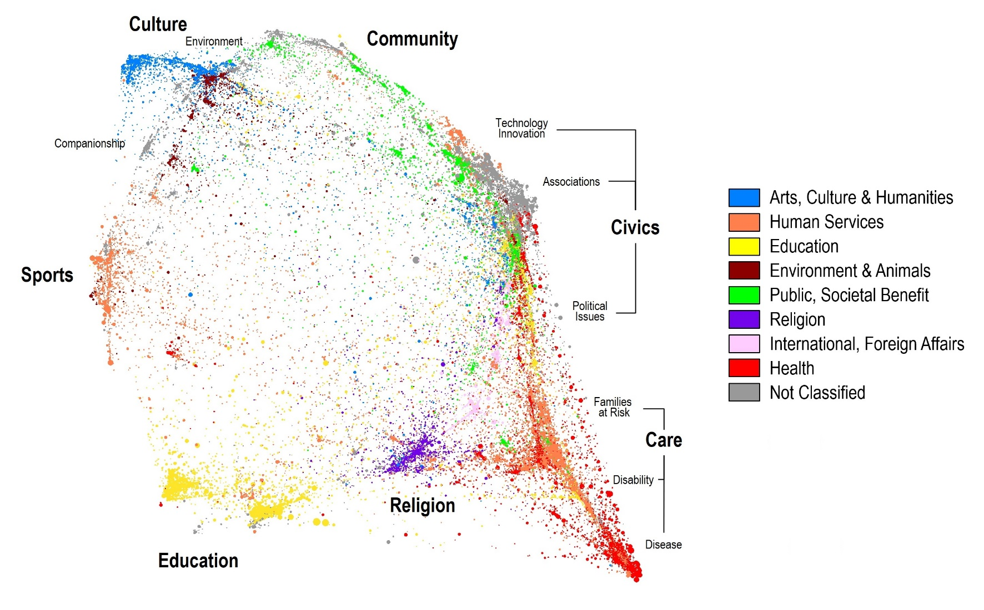
Background: Altruism
We suspect there is a strong link because non-profits fund research

Slide 10
Hypotheses
Some disciplines and strategies will be clearly motivated by economics while others will be largely motivated by altruism
Nations will differ in their research focus along an altruism-to-economic continuum
Some combination of economic, social, cultural, or political indicators will explain differences in national research strategies

Slide 11
Data: Literature
114 DC2 Disciplines based on Scopus data
    1996-2012 data originally clustered using CWTS SLM algorithm into DC5 (~90000), DC4 (~10000), DC3 (~1000), DC2 (~100) hierarchical solution
    2013-2015 data added to DC5 clusters
Scopus 2010-2013 for analysis
4429 Institutions, 110 Nations

Slide 12
Data: National characteristics

Slide 13
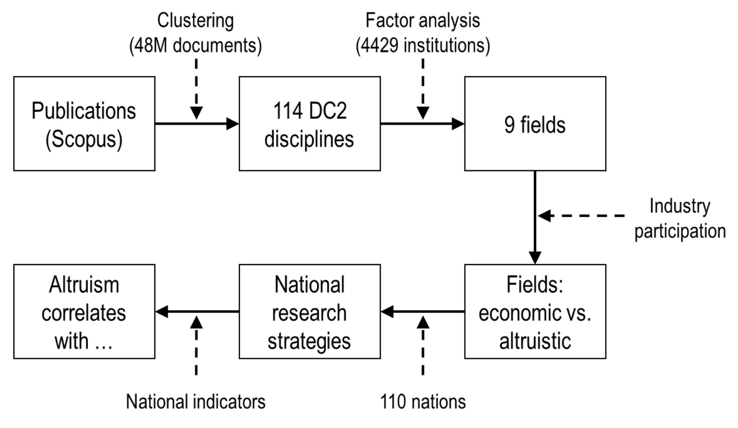
Methods

Slide 14
Results: Factor analysis
Factor analysis used to group 114 DC2 into fields
4429 institutional profiles across 114 DC2 used as input
7 factors resulted
    2 factors had strong positive and negative results – thus 2 groups each
    5 factors had only strong positive results
9 total groups of DC2 – 9 national strategies

Slide 15
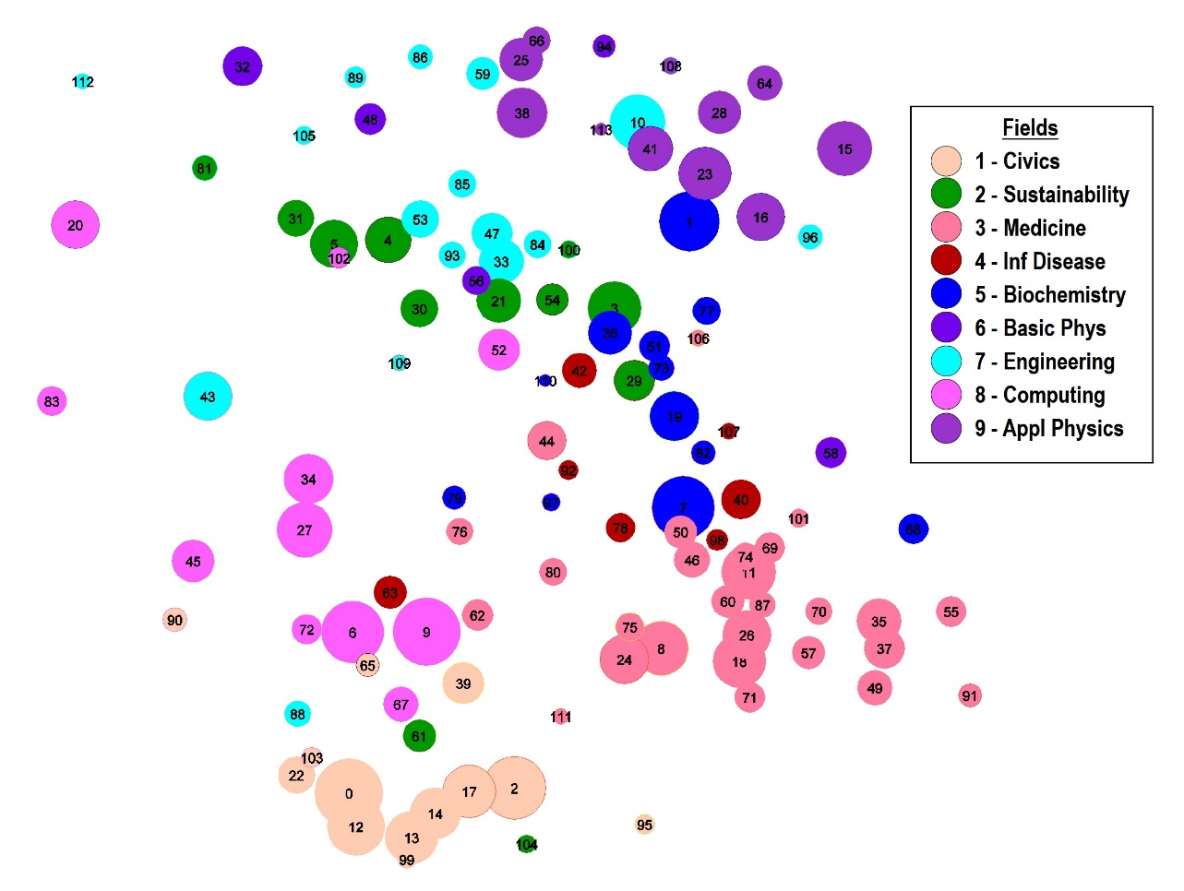
Results: Characterization
1 – Civics
2 – Sustainability
3 – Medicine
4 – Infectious Disease
5 – Biochemistry
6 – Basic Physics
7 – Engineering
8 – Computing Technology
9 – Applied Physics

Slide 16
Results: Characterization
Define the altruism-to-economic axis based on industry participation
    Relatively high industry participation – economic motive
    Relatively low industry participation – altruistic motive

Slide 17
Results: Characterization

Slide 18
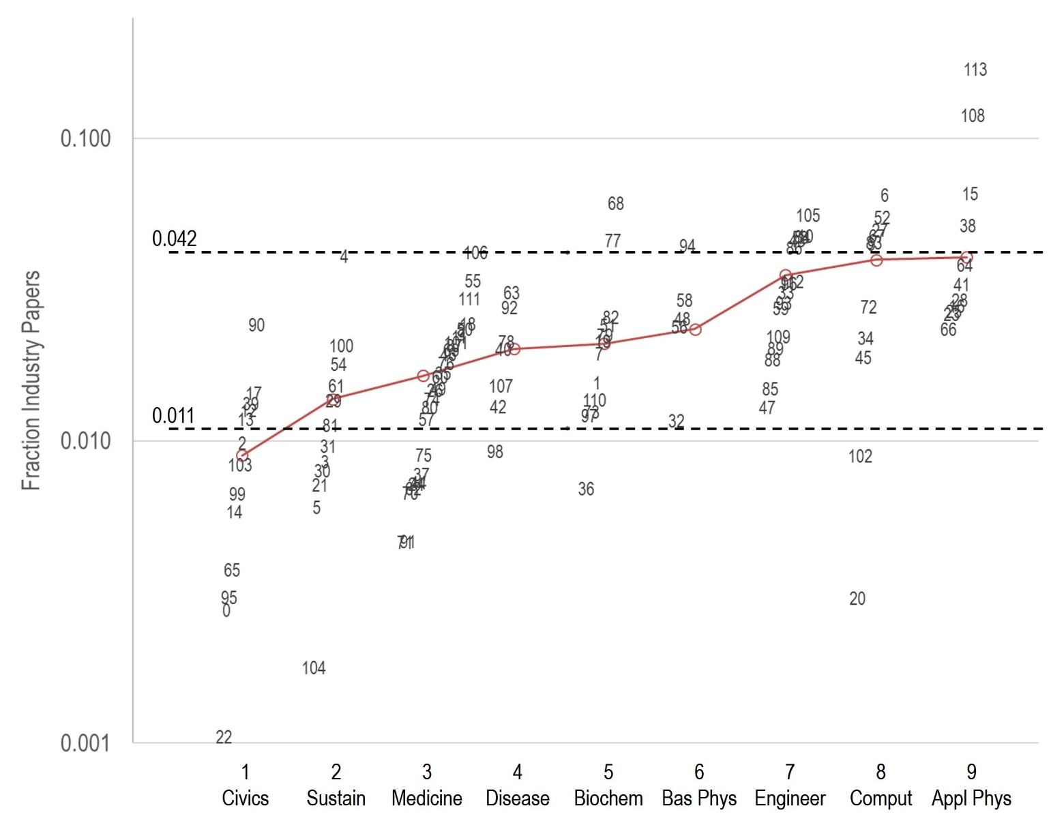
Results: Characterization

Slide 19
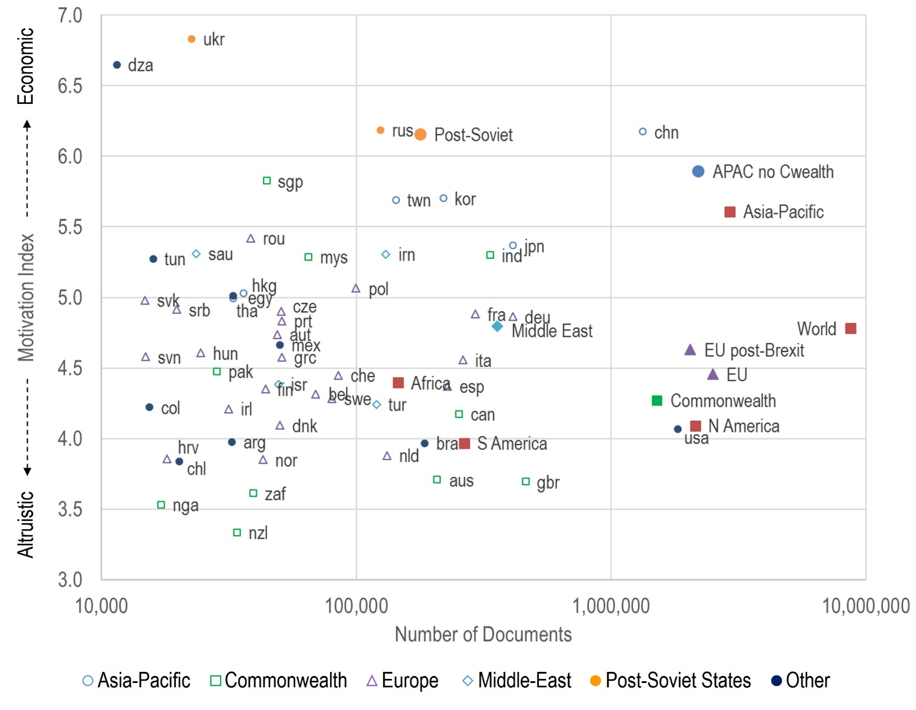
Results: Motivation index, M = ∑ f p_{f}

Slide 20
Results: Correlations with motivation index

Slide 21
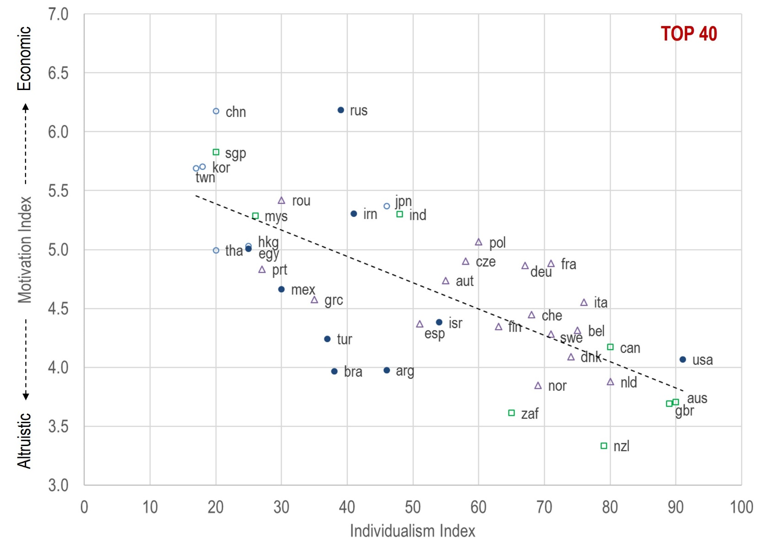
Results: Correlations

Slide 22
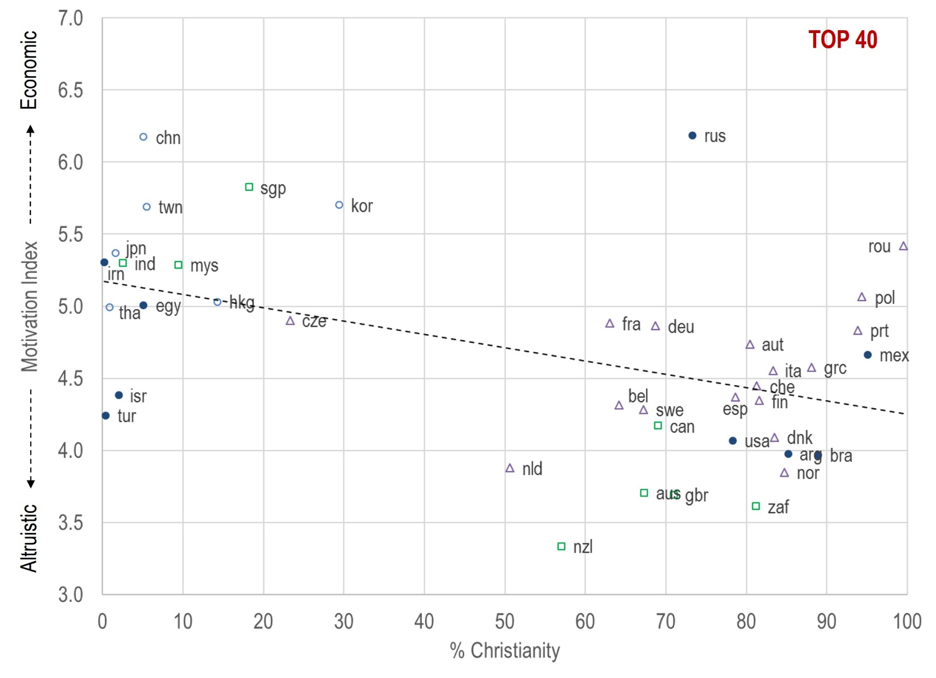
Results: Correlations

Slide 23
Results: Match to consensus
But with additional nuance and richness

Slide 24
Limitations
Database bias – all databases are biased, Scopus is biased toward English and the natural and medical sciences
    Despite this, Civics shows up as a separate field!
Industry participation limited to our 4429 institutions; we suspect industry will have higher concentration in smaller institutions, but that this will not change the ordering of the nine fields
Replication – this study can be replicated in principle, but probably not in specifics
National indicators – many other options could be considered

Slide 25
Summary
Altruism introduced into the national research strategy discussion
Disciplines and fields (strategies) vary by industry participation, and the ordering of the nine fields by this metric is consistent with past studies and with intuition
The two nations with the largest publication rates, USA and China, have very different strategies – in a sense, two exemplars
Regions (groups of countries) often have an identity along the altruism-to-economic axis
Altruism does not correlate with national wealth
For the top 40 countries, individualism correlates highly with altruistic motivation
A secondary correlation is with religion

Slide 26
Comments welcome

Slide 27
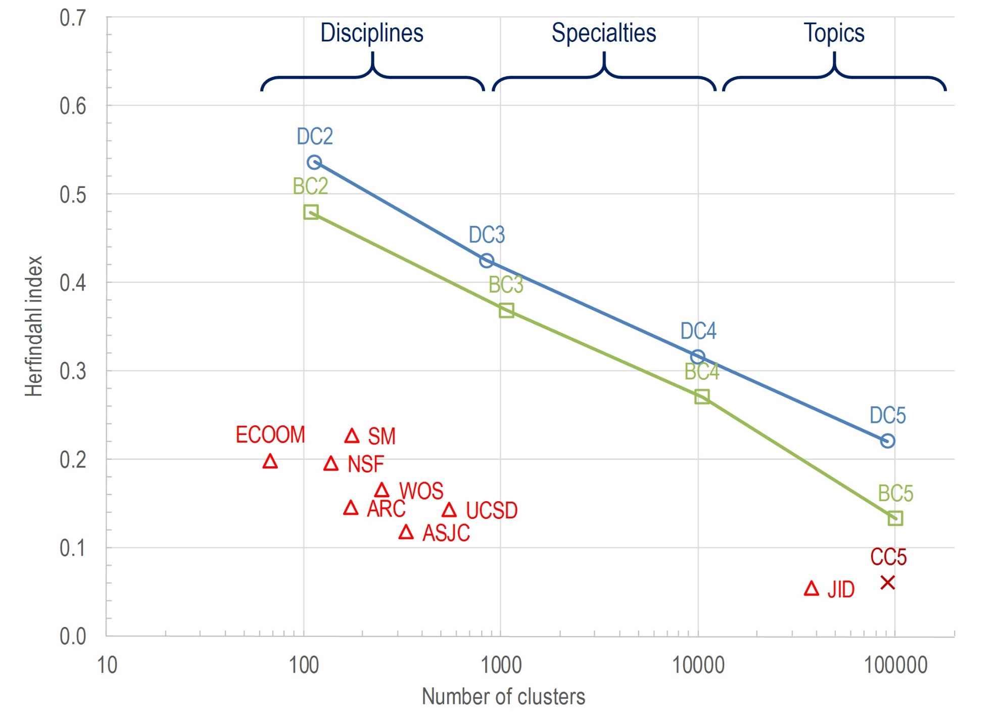
Notes:
Results are dependent on number of clusters
Higher concentration of references = More accurate clusters

Slide 28
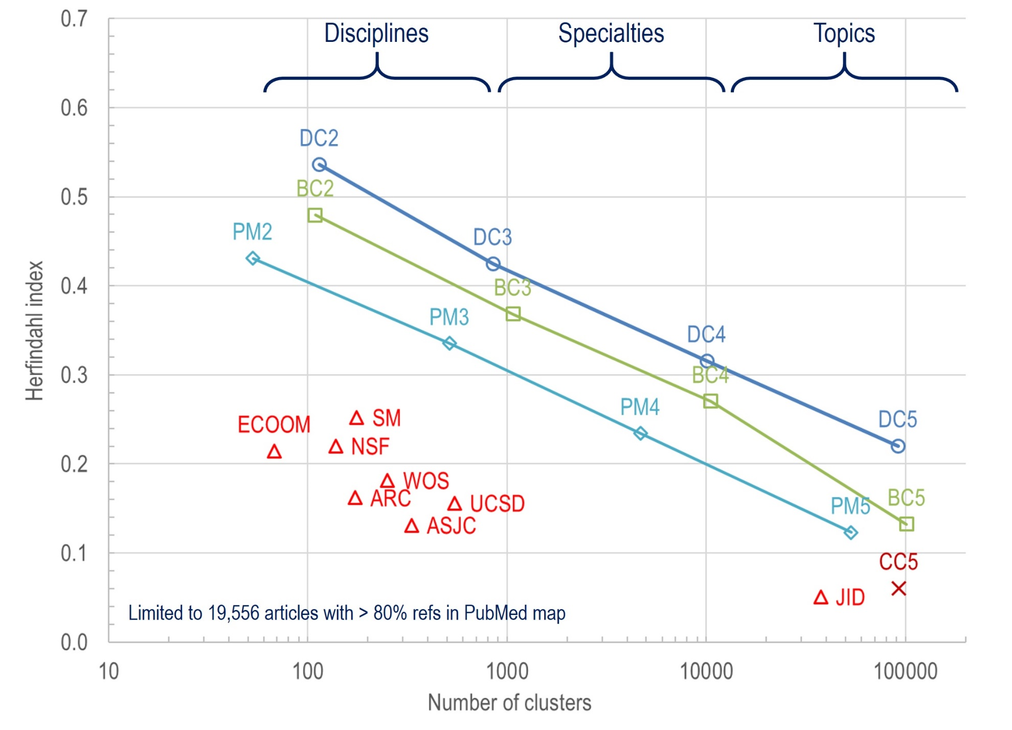
Notes:
Results are dependent on number of clusters
Higher concentration of references = More accurate clusters

Slide 29
Summary
ALL journal-based taxonomies are far less accurate than the paper-based taxonomies
Direct citation gives more accurate clusters than bibliographic coupling or co-citation

Slide 30
Implications
Newer studies are focusing on edges (links between nodes). The accuracy of edges depends on the accuracy of nodes.
Journals and journal categories are relatively inaccurate; perhaps it’s time to avoid using them

Slide 31
Full paper available
Accepted for publication in JASIST, 2016
Preprint at arxiv.org/pdf/1511.05078

